Slide 1


MightyMover

Slide 2
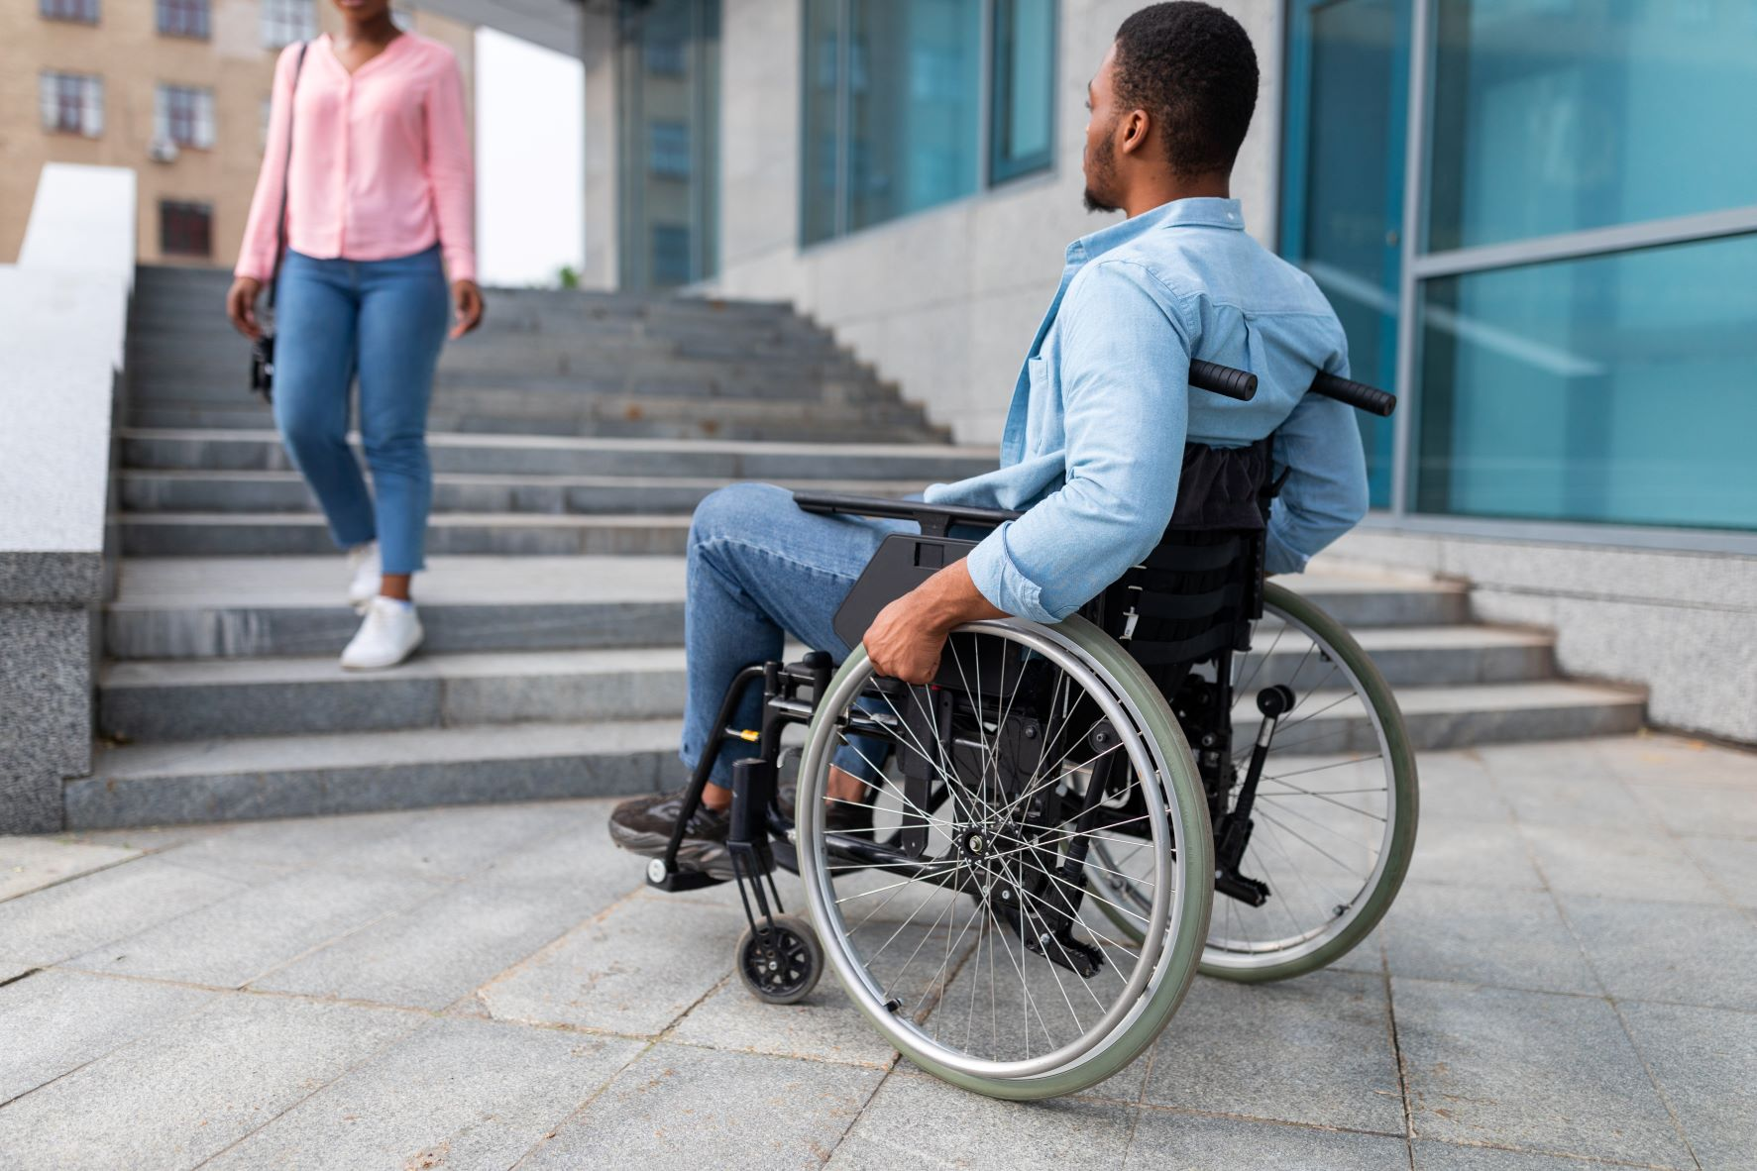
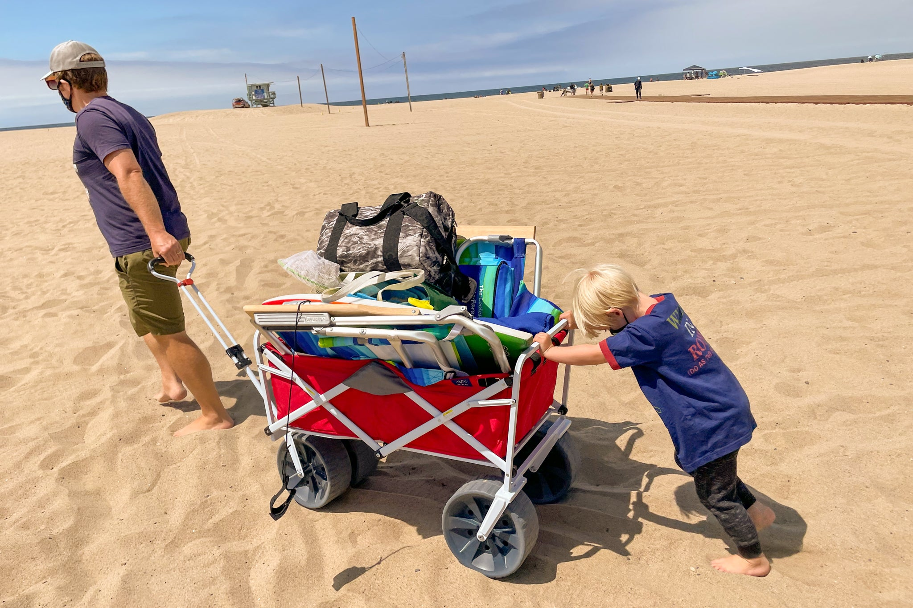
More Cache, More Problems:
Everyone has trouble carrying objects.
What solutions are there for the physically challenged?
Even wagons need to be pushed and pulled which causes strain on the body.

Slide 3
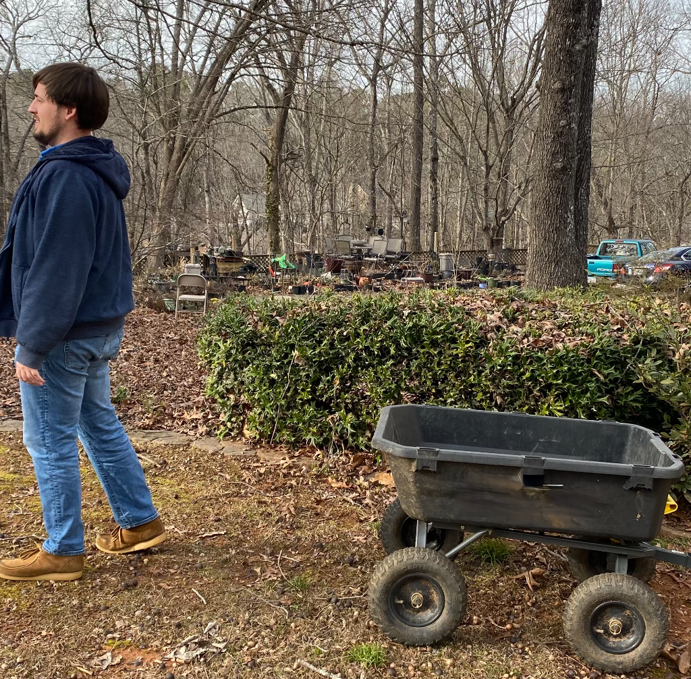
MightyMover
Our solution is a product that will get the user's items to where they want without interacting with the cart.

Slide 4
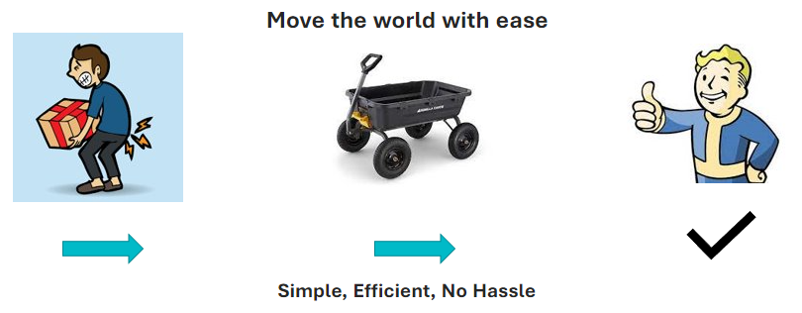

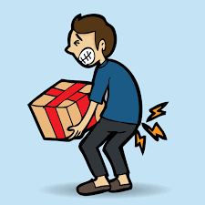
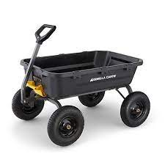


Move the world with ease
Simple, Efficient, No Hassle

Slide 5
Market Size
$48 Billion
54.1 Million
Amount American adults spend on lawn and gardening equipment every year.
Number of Americans 65 or older
$648.35 Billion in 2021
The global warehouse and storage industry has grown significantly in recent years due to a growth in e-commerce.
https://www.globenewswire.com/en/news-release/2022/11/14/2555344/0/en/Warehousing-and-Storage-Services-Market-Size-is-projected-to-reach-USD-1264-01-Billion-by-2030-growing-at-a-CAGR-of-7-70-Straits-Research.html#:~:text=The%20global%20warehousing%20and%20storage,period%20(2022-2030).
https://gardenpals.com/gardening-statistics/

Slide 6
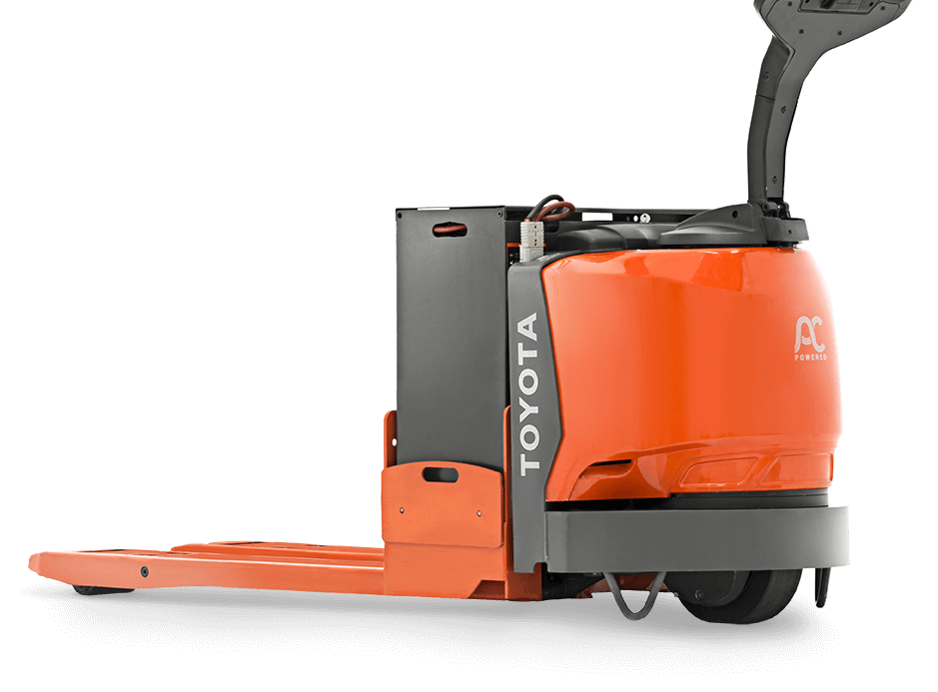
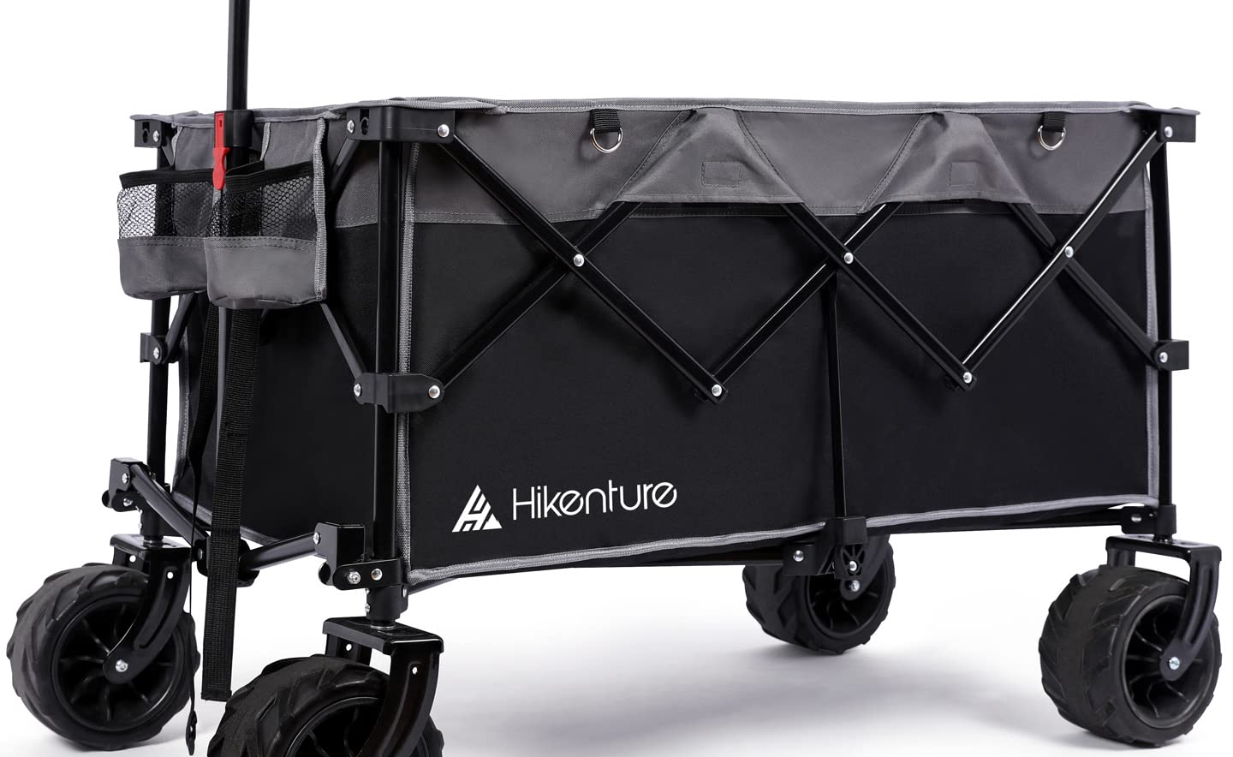
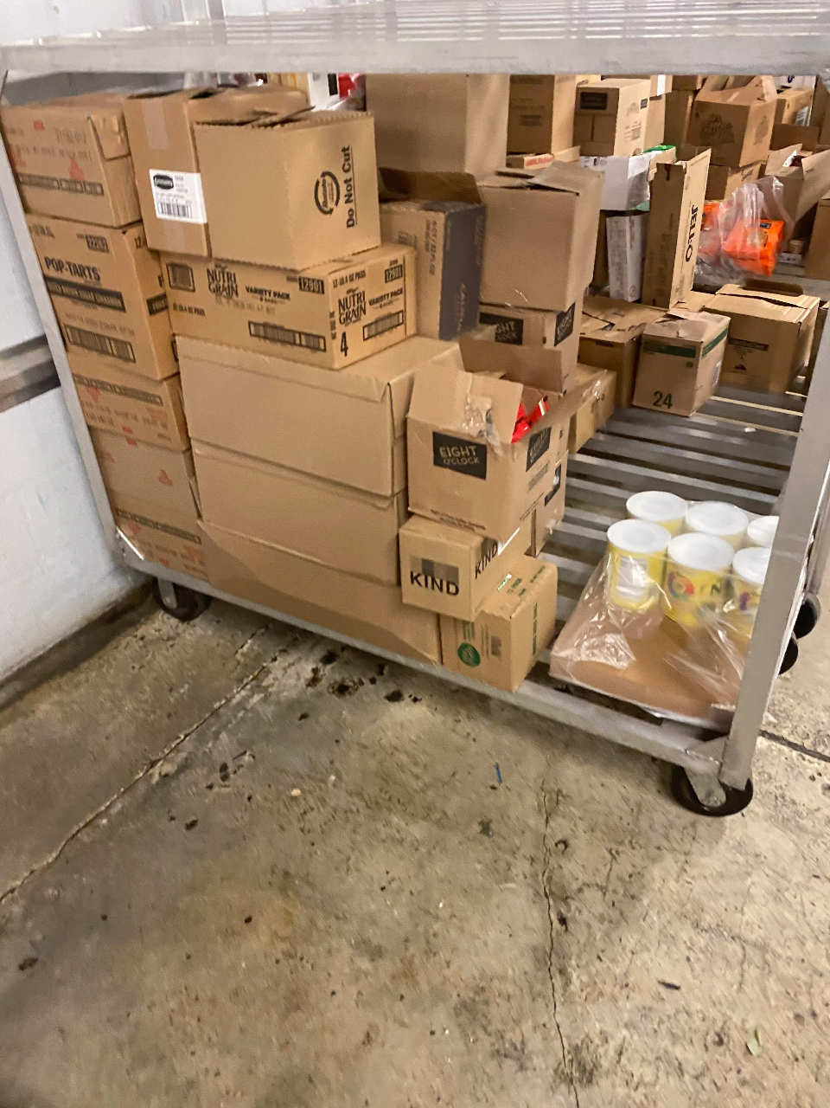
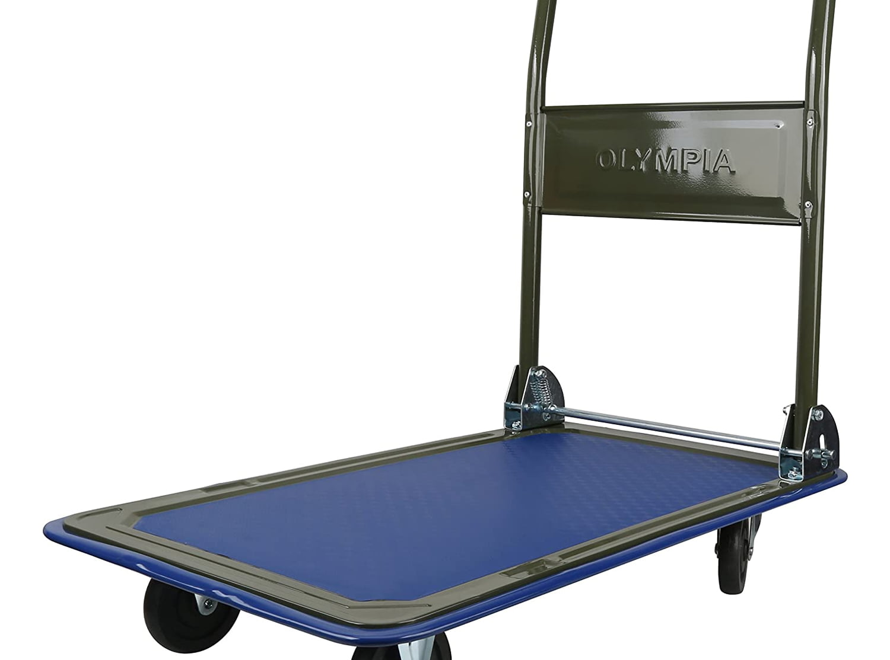
Competition
Wagons
Push Carts
Dollies
Electric Pallet Jacks
Birds

Slide 7

What's unique about MightyMover?
Self-acting solution with our auto-following feature, so you don't have to do any pushing or pulling yourself, saving you energy and reducing your chance of injury.
Additional GPS feature, allowing the user to pick a location for the product to drive to, transporting your items without you having to worry.

Slide 8
Customer Validation Data
Anthony - "Useful for loading and unloading zones within textile industries/warehouses"
- Wi-Fi/GPS based tracking is a must. To be competitive think big and avoid a large purchase price greater than $3k
Kelly - "With the right features, I would buy immediately“
- Is a gardener with limited mobility, so it is crucial to have features geared towards making it easier to load/unload items from the cart
Sharon - "The hardest part of gardening is lifting heavy plant pots; this would help me a lot"
-Elderly Gardener, has trouble lifting bags of soil and heavy plant pots, having a device that could travel from the front yard to the back yard would help her a lot

Slide 9


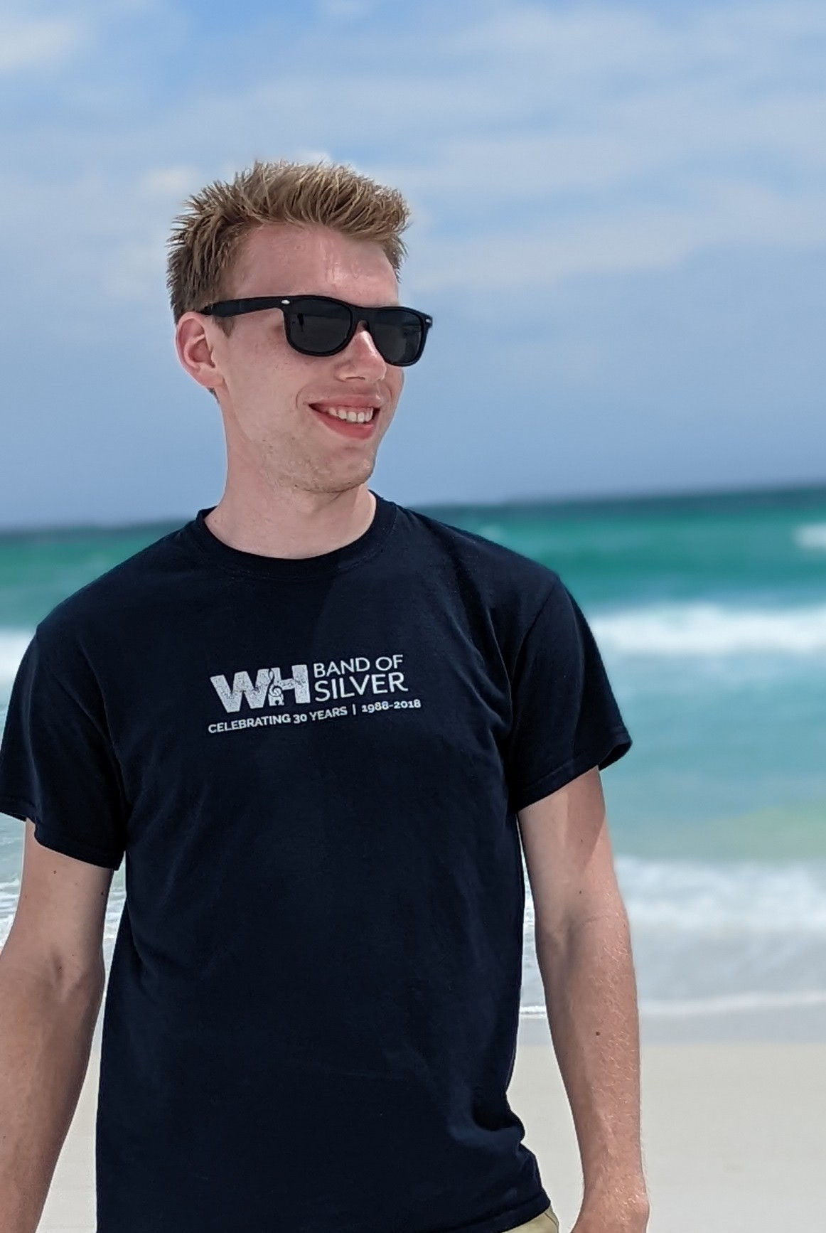
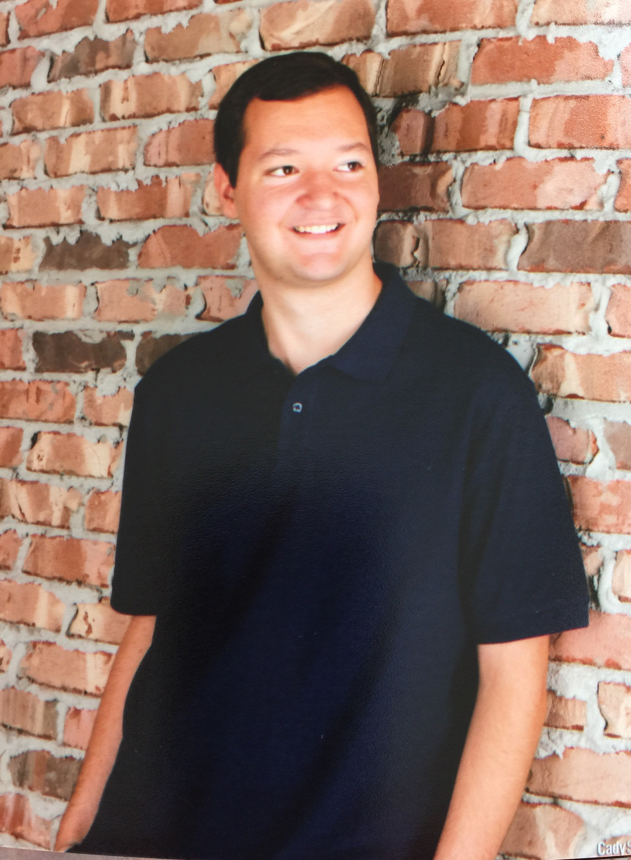
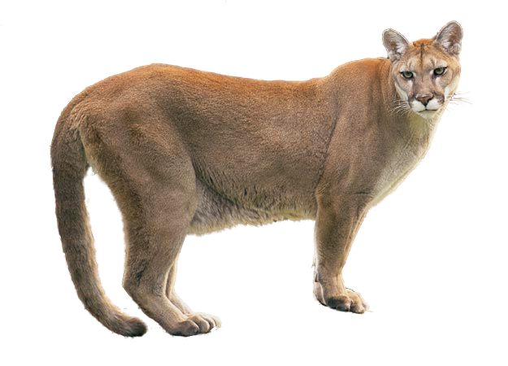
The Team behind CacheMoney
Grant
Hanson
Chris
Cooper
Project Manager
Design Engineer
Electrical Engineer
Software Developer

Slide 10

Thank You

